Slide 1

ICT502
Week 8: Writing and Presenting IT Project Reports
ICT502 Applied IT Project A
1

Slide 2
What we learned last week
Why Does Communication Fail in Project Management?
Significance of Communication in Managing Projects
Types of Communication in Project Management
Key Steps to Manage Communication in IT Projects

Slide 3
Why IT Project Reports Matter
In Real Industry:
Reports are used to:
explain problems,
justify solutions,
communicate with clients,
request approval,
guide implementation.
Assessment 4 is not just an assignment. It simulates a real IT proposal document.

Slide 4
Common Student Mistakes in Reports
X Too descriptive X No clear business problem X Weak justification X No evidence/data X Poor structure X Only talking about technology X No client focus X No sustainability discussion

Slide 5
Assessment 4 = Professional IT Proposal
Students Should Think Like:
IT consultant
Business analyst
Project coordinator
NOT:
“I am writing a university assignment.”
BUT:
“I am proposing a real IT solution to NSW IT Support.”

Slide 6
Understanding Report Objectives
Before Writing, Ask:
“What is the purpose of my report?”
Possible objectives:
solve a business problem,
improve customer support,
improve cybersecurity,
automate processes,
improve communication,
reduce operational cost.

Slide 7
Define Scope Clearly
Scope = What Your Project Includes
Example:
Included:
✔ AI ticketing system ✔ cloud dashboard ✔ automated alerts
Not Included:
✘ full company ERP system ✘ hardware replacement ✘ accounting systems
Scope helps keep projects realistic.

Slide 8
Understanding the Audience
Who Will Read Your Report?
Possible readers:
NSW IT Support managers
technical staff
academic assessors
clients
non-technical stakeholders

Slide 9
Writing for Different Audiences
Technical Audience
Can understand:
databases,
APIs,
cybersecurity tools,
cloud infrastructure.

Slide 10
Writing for Different Audiences
Non-Technical Audience
Need:
simple explanations,
business benefits,
cost/value focus.
Students should avoid too much technical jargon.

Slide 11
Questions Students Can Ask NSW IT Support
To Improve Their Report
Business Questions
What business problem is most urgent?
Which services are hardest to manage?
What processes are still manual?
What causes delays in customer support?

Slide 12
Questions Students Can Ask NSW IT Support
Technical Questions
What systems do you currently use?
What security challenges do you face?
Do you use cloud-based systems?
Client Questions
What do clients complain about most?
What features do clients request?

Slide 13
Questions About Data & Evidence
Assessment 4 Needs Evidence
Students Can Ask:
How many support tickets are handled monthly?
What are the most common incidents?
What causes the longest delays?
Are there common cybersecurity issues?
What areas consume the most staff time?
This helps students justify their solution.

Slide 14
Example: Turning Company Information into Report Content
Company Problem:
Slow support ticket handling
Report Problem Statement:
NSW IT Support handles a large number of support requests, creating delays in issue resolution and reducing customer satisfaction.

Slide 15
Example: Turning Company Information into Report Content
Proposed Solution:
AI-assisted ticket prioritisation system
This is how students transform company discussions into professional report writing.

Slide 16
Gathering Facts and Data
Good Reports Use:
✔ company information ✔ statistics ✔ research papers ✔ industry reports ✔ client needs ✔ technology comparisons

Slide 17
Example Sources Students Can Use
Academic Sources
Google Scholar
IEEE papers
cybersecurity journals
Industry Sources
AWS
Microsoft
IBM
Cisco

Slide 18
Example Sources Students Can Use
Company Information
NSW IT Support website
discussions/interviews
client services

Slide 19
Report Structure for Assessment 4
1. Executive Summary
Short overview
2. Problem Definition
What is the issue?
3. Proposed Solution
What system solves it?
4. Design & Technology
How will it work?

Slide 20
Report Structure for Assessment 4
5. Ethics & Risks
What could go wrong?
6. Communication & Future Development
How will stakeholders stay informed?
7. Conclusion
Why is the project valuable?

Slide 21
Helping Students Write Better Solutions
Weak Solution Example
“We will use cloud computing.”
X Too vague
Better Example
“We propose a cloud-based ticket management system using AWS to improve scalability, remote access, and response time.”
✔ Specific ✔ Justified ✔ Business-focused

Slide 22
Sustainability Section (Students Often Forget)
Students Must Explain:
Environmental Sustainability
cloud reduces hardware usage
Economic Sustainability
automation reduces labour cost
Social Sustainability
improved accessibility and customer service

Slide 23
Questions About Sustainability
Students Can Ask:
How do you reduce operational costs?
Do clients request environmentally friendly solutions?
How important is remote/cloud work?
Do clients prefer scalable cloud systems?

Slide 24
Ethical & Security Questions
Important for Assessment 4
Students Can Ask:
How do you protect client data?
What cybersecurity risks are most common?
How do you manage privacy?
How do you control employee access?

Slide 25
Example Challenges & Possible Student Solutions
Challenge | Possible Solution
Slow support response | AI chatbot
Cyber attacks | Security monitoring dashboard
Manual ticket sorting | Automated classification
Client communication delays | Customer portal
Data management issues | Cloud database system

Slide 26
Professional Report Writing Tips
✔ Use headings clearly ✔ Write short clear paragraphs ✔ Use diagrams/tables ✔ Explain WHY technology is chosen ✔ Connect technology to business value ✔ Support claims with evidence

Slide 27
Final Advice for Assessment 4
High-Quality Reports:
✔ solve real business problems ✔ use realistic technologies ✔ explain implementation clearly ✔ justify decisions ✔ communicate professionally ✔ combine business + technical thinking

Slide 28
Final Message to Students
Think Like an IT Consultant
Ask yourself:
What problem am I solving?
Why is my solution useful?
How will it help NSW IT Support?
Is my solution realistic?
How would I explain this to a real client?

Slide 29
Mini Report Example
Example:
Problem
Clients experience slow response times.
Evidence
NSW IT Support manages 8000+ resolved tickets.
Solution
Cloud-based AI ticketing system.
Benefit
Faster response, improved customer satisfaction, reduced workload.

Slide 30
Week 8 Pre-Class Readings
YouTube Video:
How to Make a Project Status Report Template with PowerPoint:
https://www.youtube.com/watch?v=Pmabm_iKm_8&t=935 s

Slide 31
Week 8 Pre-Class Readings
Key Messages / Lessons (Simple Terms)
Use simple and clear reports A project status report should be easy to read and understand quickly.
PowerPoint is useful for reports PowerPoint works well because it is easy to access, looks good on screens, and limits too much writing.
Keep reports short and focused The limited slide space encourages people to only include important information.

Slide 32
Week 8 Pre-Class Readings
Plan the report structure first Listing all sections before starting helps avoid forgetting important details.
Use company branding Adding logos and company colours makes reports look professional and consistent.
Tables help organise information Tables make project information neat, structured, and easier to compare.

Slide 33
Week 8 Pre-Class Readings
RAG status helps show project health Red, Amber, and Green indicators quickly show whether parts of the project are on track.
Include key project updates Reports should include: Current project summary
Deliverables completed
Upcoming deliverables
Risks and issues
Actions to fix problems

Slide 34
Week 8 Pre-Class Readings
Focus on important information Stakeholders usually care more about:
Go-live dates
Risks
Budget
Deliverables than unnecessary details.

Slide 35
Week 8 Pre-Class Readings
Formatting matters Good alignment, readable fonts, and consistent colours make reports easier to understand.
Always save your work regularly Saving often prevents losing progress.
Think about the reader Reports should help busy people quickly understand project status and decisions needed.

Slide 36
Design Discussion Questions
Question 1
Why did the presenter choose PowerPoint instead of Word or Excel?
Because PowerPoint is easy to access, works well on screens, and encourages shorter and clearer reports.

Slide 37
Design Discussion Questions
Question 2
What is the purpose of using RAG status indicators?
RAG indicators (Red, Amber, Green) quickly show whether different parts of the project are doing well or need attention.

Slide 38
Design Discussion Questions
Question 3
Why is it important to keep project reports brief?
Busy stakeholders do not have time to read long reports. Short reports help them understand key information quickly.

Slide 39
Design Discussion Questions
Question 4
What information should be included in a project status update section?
The section should include:
Current project progress
Major achievements
Problems or challenges
Important updates

Slide 40
Design Discussion Questions
Question 5
Why should company branding be included in reports?
Company branding makes reports look professional and consistent with other company documents.

Slide 41
Design Discussion Questions
Question 6
Why are tables useful in project status reports?
Tables organise information clearly and make reports easier to read and compare.

Slide 42
Design Discussion Questions
Question 7
What are “Return to Green” actions?
These are actions planned to fix project problems and move project status back to green (healthy/on track).

Slide 43
Design Discussion Questions
Question 8
Why is it important to include risks and issues in reports?
It helps stakeholders understand potential problems and what is being done to solve them.

Slide 44
Design Discussion Questions
Question 9
What project information is most important for stakeholders?
Important information includes:
Budget
Go-live date
Risks
Deliverables
Project health status

Slide 45
Design Discussion Questions
Question 10
Why should formatting and alignment be carefully checked?
Good formatting improves readability and makes the report look professional.

Slide 46
Design Discussion Questions
Short Reflection Question
How can a well-designed project status report help a project team?
A well-designed project status report helps the team communicate progress clearly, identify problems early, and keep stakeholders informed for better decision-making.

Slide 47
Week 8 Topics
Introduction to IT Project Reports
Define Report Objectives and Scope
Understand Your Audience
Report Format and Type
Gather the Facts and Data
Structure the Report

Slide 48
Pre-Class Discussion
YouTube Video:
Report Writing: How to Write a Project Report? https://www.youtube.com/watch?v=KuFPjmx-jCY

Slide 49
Pre-Class Discussion
Key Messages / Lessons (Simple Terms)
A project report must have a proper title page The title page should include:
Project title
Student name
Roll number/ID
University or college name
Faculty or supervisor name

Slide 50
Pre-Class Discussion
The first page is very important A neat and professional cover page creates a good first impression.
Use pictures related to the topic Adding suitable images makes the report more attractive and easier to understand.

Slide 51
Pre-Class Discussion
Follow proper formatting rules Reports should use:
Clear headings
Correct font style (such as Times New Roman)
Proper font size
Line spacing
Bold headings

Slide 52
Pre-Class Discussion
Include a table of contents The table of contents helps readers quickly find chapters and sections.
Organize reports into chapters and subheadings Each chapter should focus on one topic and use subheadings for better structure.

Slide 53
Pre-Class Discussion
Use references and sources properly Information taken from books, websites, newspapers, or magazines should be properly referenced.
Use updated and reliable information Students should collect information from trustworthy and recent sources.

Slide 54
Pre-Class Discussion
Pictures, charts, and diagrams improve reports Visual elements make reports more interesting and easier to explain.
Appendices can include extra information Large tables, detailed data, or additional documents can be added in the appendix section

Slide 55
Pre-Class Discussion
Technical and project reports should be well-structured A good report should be neat, clear, and logically organised.
Good presentation improves marks Proper formatting, clean layout, and organised content help create a professional report.

Slide 56
Pre-Class Discussion
Design Discussion Questions and Answers
Question 1
What information should be included on the title page of a project report?
The title page should include:
Project title
Student name
Roll number/student ID
University or college name
Faculty or supervisor name

Slide 57
Pre-Class Discussion
Question 2
Why is the cover page important in a report?
The cover page creates the first impression and makes the report look professional.
Question 3
Why should pictures be added to a project report?
Pictures help explain ideas clearly and make the report more attractive for readers.

Slide 58
Pre-Class Discussion
Question 4
What is the purpose of a table of contents?
The table of contents helps readers find chapters and sections easily.
Question 5
Why should reports use headings and subheadings?
Headings and subheadings organise information clearly and improve readability.

Slide 59
Pre-Class Discussion
Question 6
What font style was recommended in the video?
The video recommended using Times New Roman font.
Question 7
Why are references important in project reports?
References show where the information came from and help avoid plagiarism.

Slide 60
Pre-Class Discussion
Question 8
What kinds of sources can be used in references?
Sources may include:
Books
Websites
Newspapers
Magazines
Research articles

Slide 61
Pre-Class Discussion
Question 9
What is an appendix in a report?
An appendix contains extra supporting information such as charts, tables, or additional documents.
Question 10
How does proper formatting improve a report?
Proper formatting makes the report easier to read, more organised, and more professional.

Slide 62
Pre-Class Discussion
Short Reflection Question
Why is report organisation important in academic or technical projects?
Good organisation helps readers understand the information easily, improves communication, and makes the report look professional and credible

Slide 63
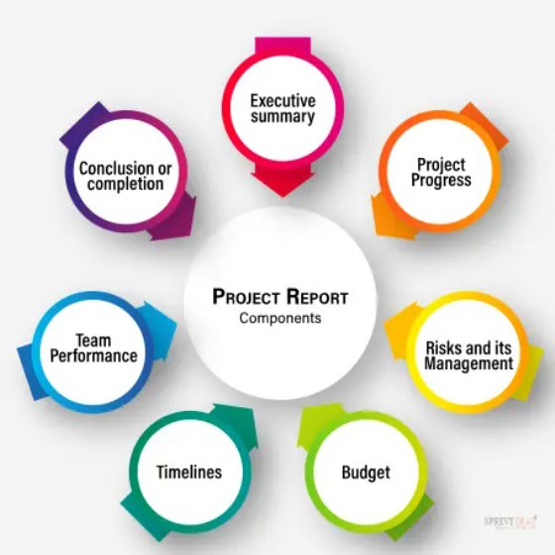
Introduction to Project Reports

Slide 64
Introduction to Project Reports (cont.)
Understanding Project Reports
Definition and Purpose: IT project reports are structured documents that communicate project progress, outcomes, and insights to stakeholders.
Importance: They ensure clear communication, inform decision-making, and align stakeholders towards project goals.
Types of IT Project Reports
Progress Reports: Updates on project activities and achievements.
Status Updates: Current project status and upcoming tasks.
Technical Documentation: Detailed project specifications and design decisions.
Final Project Reports: Summarize project lifecycle, outcomes, and recommendations.

Slide 65
Introduction to Project Reports (cont.)
Key Considerations in Project Reporting:
Timeliness and Relevance:
Project reports should be timely, providing up-to-date information relevant to the current project phase or milestone.
They should address the immediate needs and concerns of stakeholders to facilitate informed decision-making and support project progression.
Accuracy and Transparency:
Reports must be accurate, reflecting true project status, achievements, challenges, and risks.
Transparency ensures stakeholders trust the information presented and can make decisions based on reliable data and insights.

Slide 66
Define Report Objectives and Scope
1. Defining Report Objectives
Importance of Setting Clear Objectives:
Clear objectives provide focus and purpose to the report.
They guide what information to include, ensuring relevance and effectiveness.
Aligned objectives connect the report directly to project goals and stakeholder needs.
Aligning Objectives with Project Goals and Stakeholder Expectations:
Objectives should support project milestones and outcomes.
Meeting stakeholder expectations ensures the report delivers valuable insights.

Slide 67
Define Report Objectives and Scope (cont.)
2. Establishing Scope and Boundaries
Defining the Scope of the Report:
Outline what will be covered, such as project phases or specific outcomes.
Specify exclusions to maintain focus and clarity.
Setting Boundaries for Relevance:
Ensure the report remains concise and pertinent to stakeholders.
Manage expectations and prevent scope creep.

Slide 68
Understand Your Audience
Understanding your audience is crucial for crafting a report that resonates. Whether you’re writing for stakeholders or team members, the language, data, and visuals should be tailored to their preferences and needs.
Language & Tone: Consider the communication style of your audience. Is a formal or informal tone more appropriate? Tailoring your language can build rapport and make your message more impactful.
Data & Graphics: Choose the types of data and visual aids that will most effectively convey your message to your specific audience.

Slide 69
Understand Your Audience (cont.)
Personal Preferences: Pay attention to how your audience typically communicates, whether in emails or other documents and try to mirror that style.
Report Format: Different stakeholders may require different levels of detail. A project manager may want an in-depth analysis, while a sponsor only needs an executive summary.
Audience Personas: Utilize audience personas to guide the tone, style, and content, ensuring your report caters to the diverse needs of all project stakeholders.

Slide 70
Report Format and Type: Choosing the Right Report Format
Choosing the Right Report Format
Factors to Consider:
Audience: Tailor the report format to suit the knowledge level and preferences of the audience.
Purpose: Determine whether the report is meant to inform, persuade, or recommend actions.
Nature of Information: Consider whether the information is qualitative, quantitative, technical, or strategic.
Selecting Appropriate Formats:
Textual: Use for detailed explanations, analysis, and descriptions.
Graphical: Utilize charts, graphs, and diagrams for visual representation of data and trends.
Combination: Combine textual and graphical elements to enhance clarity and engagement.

Slide 71
Report Format and Type: Structuring the Report
Structuring the Report
Overview of Common Report Structures:
Title Page: Includes the title, author, date, and possibly the organization.
Executive Summary: Provides a concise overview of the report's purpose, methods, findings, and recommendations.
Introduction: Sets the context, objectives, and scope of the report.
Methodology: Describes how data was collected or analyzed.
Results: Presents findings, data, and observations from the study.
Discussion: Analyzes the implications of the results and their significance.
Conclusions: Summarizes key findings and their implications.
Recommendations: Suggests actions based on the conclusions.
References: Lists sources cited in the report.

Slide 72
Report Format and Type: Structuring the Report (cont.)
Guidelines for Organizing Information:
Logical Flow: Arrange sections in a logical sequence that follows the reader's journey through the report.
Coherence: Ensure each section connects seamlessly to the next, building a cohesive narrative.
Clarity: Use clear headings, subheadings, and transitions to guide the reader through complex information.

Slide 73
Gathering the Facts and Data: Data Collection Methods
Methods for Gathering Data:
Surveys: Use questionnaires to collect structured data from a large sample of respondents.
Interviews: Conduct one-on-one or group interviews to gather in-depth insights and opinions.
Observations: Observe behaviors, interactions, or processes to gather firsthand data.
Documentation Review: Analyze existing records, reports, and documents to gather historical or factual information.
Ensuring Data Integrity and Reliability:
Verification: Confirm the accuracy of data through cross-referencing with multiple sources or methods.
Validation: Assess the consistency and reliability of data to ensure it reflects the true situation or phenomenon.

Slide 74
Gathering the Facts and Data: Analyzing Data
Techniques for Analyzing Qualitative Data:
Thematic Analysis: Identify patterns and themes within textual data.
Content Analysis: Systematically analyze text-based data to draw inferences or conclusions.
Narrative Analysis: Interpret stories or narratives to understand underlying meanings.
Techniques for Analyzing Quantitative Data:
Descriptive Statistics: Summarize and describe numerical data using measures such as mean, median, and mode.
Inferential Statistics: Make inferences and predictions about a population based on sample data using techniques like regression analysis or hypothesis testing.
Data Visualization: Present quantitative data visually through charts, graphs, and tables to facilitate understanding and interpretation.

Slide 75
Gathering the Facts and Data: Analyzing Data (cont.)
Interpreting Findings and Drawing Conclusions:
Contextualize Results: Relate findings back to the project objectives and research questions.
Identify Patterns and Trends: Highlight significant trends or patterns observed in the data.
Draw Implications: Discuss the implications of findings for decision-making or further research.

Slide 76
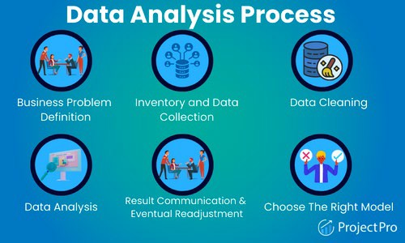
Gathering the Facts and Data: Analyzing Data (cont.)

Slide 77
Gathering the Facts and Data: Structure the Report
How you arrange your report is pivotal in how well your audience can digest the material. A logically organized report improves readability and amplifies its impact in delivering the core message.
Your report should have a natural progression, leading the reader from one point to the next until a decisive conclusion is reached.

Slide 78
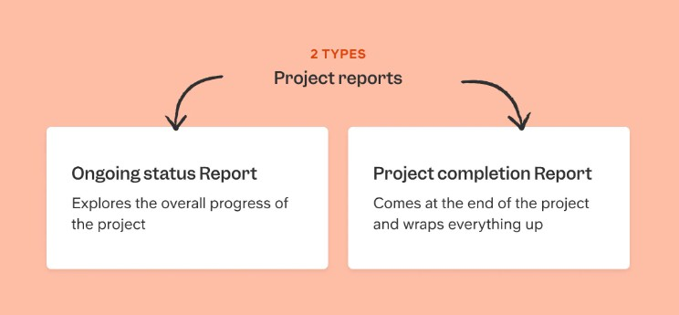
Gathering the Facts and Data: Structure the Report

Slide 79
Group Discussion Case Study
Scenario: Final Project Report Presentation
You are part of a team that has completed a six-month software development project. You are preparing a final project report presentation to be delivered to senior management and stakeholders.
Questions:
What are the key elements that should be included in your final project report presentation?
How would you structure your presentation to ensure clarity and coherence?
What strategies would you use to effectively communicate the project's outcomes, challenges, and recommendations to your audience?

Slide 80
Case Study: Discussion Points
Key Elements in the Final Project Report Presentation:
Introduction: Overview of project objectives, team introduction.
Project Overview: Timeline, phases, milestones.
Achievements: Deliverables and their alignment with client requirements.
Challenges: Major obstacles faced and strategies used.
Results: Quantitative and qualitative project outcomes.
Recommendations: Future improvements and sustainability strategies.
Conclusion: Recap of key points and project impact

Slide 81
Case Study: Discussion Points
Presentation Structure for Clarity:
Clear Sections: Use a structured approach (introduction, overview, achievements, challenges, results, recommendations, conclusion).
Visual Aids: Charts, graphs to illustrate data effectively.
Engagement: Interactive elements, storytelling techniques.
Time Management: Allocate time wisely, practice timing

Slide 82
Case Study: Discussion Points
Communication Strategies:
Tailored Messaging: Adapt content to audience knowledge and interests.
Evidence-Based Approach: Support with data, metrics, examples.
Clarity and Simplicity: Use simple language, summarize complex information.
Open Dialogue: Encourage questions, provide clarifications.

Slide 83
Summary
Introduction to Project Reports and Scope: Learn the fundamental importance of project reports in documenting progress and outcomes.
Define Report Objectives: Clarify the specific goals and purposes that each project report aims to achieve.
Understand Your Audience: Tailor reports to effectively communicate with stakeholders by analyzing their needs and preferences.
Report Format and Type: Choose appropriate formats—textual or graphical—based on content to enhance readability and understanding.
Gather the Facts and Data: Employ various methods such as surveys, interviews, and data analysis to ensure accuracy and reliability.

Slide 84
Question?
Q&A

Slide 85

Week 8 Workshop :
Writing and Presenting IT Project Reports
ICT502
ICT502 Applied IT Project A
85

Slide 86

IT Project Capstone Guide

Slide 87
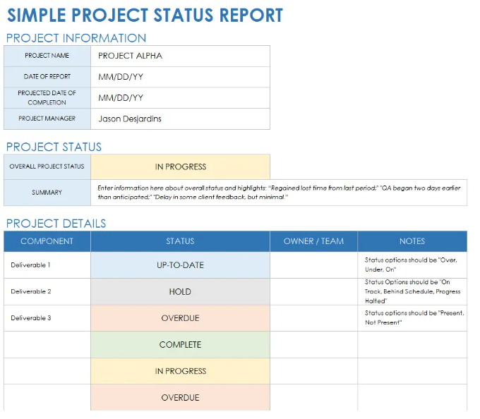
Simple Project Status Report Template

Slide 88
Introduction to Ongoing Status Reports
Importance in Project Management:
Ongoing status reports play a crucial role in project management by providing regular updates on the project's progress, current status, and any issues or risks that may impact its success.
These reports help stakeholders, including project sponsors, team members, and clients, stay informed about project developments and ensure alignment with project goals and timelines.

Slide 89
Introduction to Ongoing Status Reports
Objectives:
Monitoring Progress: Track milestones, tasks completed, and overall project timeline adherence.
Identifying Issues: Highlight challenges, risks, or bottlenecks that require attention and mitigation strategies.
Communicating Updates: Keep stakeholders informed about achievements, resource utilisation, and any adjustments to project plans.

Slide 90
Key Components of an Ongoing Status Report
Key Components:
Project Overview:
Provide a brief summary of the project's objectives, scope, and timeline to contextualise the ongoing progress updates.
Include key metrics such as project start date, expected completion date, and major deliverables.
Progress Update:
Detail milestones achieved during the reporting period and compare against the project timeline.
Summarise tasks completed, ongoing activities, and any deviations from the original plan.
Resource Utilisation:
Report on budget expenditure, resources allocated (e.g., personnel, equipment), and their efficiency metrics (e.g., burn rate, resource utilisation rates).
Discuss any adjustments made to resource allocation based on project needs or unexpected challenges.

Slide 91
Video: Project Status Reports
Watch this video. Project Status Reports: Everything you need to know and more!
Watch this video to learn :
https://www.youtube.com/watch?v=U1oSjjNervA

Slide 92
Video: Project Status Reports
Key Messages / Lessons
Project managers must track project progress One of the main jobs of a project manager is checking how the project is going and updating the team and clients.
Project status reports help communication Status reports keep everyone informed about:
progress,
problems,
timelines,
and next steps

Slide 93
Video: Project Status Reports
Reports should clearly identify the project Every report should explain:
what project it is about,
and who the report is for.
Include the project vision or goal The report should briefly explain the purpose or goal of the project.

Slide 94
Video: Project Status Reports
Use RAG status (Red, Amber, Green) RAG status helps quickly show project health:
Green = project is doing well
Amber = some issues exist
Red = major problems exist

Slide 95
Video: Project Status Reports
6. Always explain the status Do not only show colours. Add short notes explaining why the project is green, amber, or red.
7. Track budget and timeline Reports should show whether the project is staying within:
budget,
schedule,
and deadlines.

Slide 96
Video: Project Status Reports
8. Include completed and upcoming tasks Reports should explain:
what has already been finished,
and what will happen next.
9. Mention risks and roadblocks Important problems should be clearly reported early before they become bigger issues.

Slide 97
Video: Project Status Reports
10. Milestones are important Major project goals and deadlines should be clearly listed.
11. Keep reports short and simple Good reports are:
clear,
concise,
easy to read,
and focused on important information.

Slide 98
Video: Project Status Reports
12. Do not blame people in reports Reports should stay professional and avoid attacking team members or clients.
13. Do not ask too many questions in reports Reports should provide answers and updates, not confusion. 14. Gather information before writing Project managers should collect data and speak with the team before preparing the report.

Slide 99
Video: Project Status Reports
15. Templates save time Using templates helps create reports faster and more consistently.
16. First drafts do not need to be perfect Start writing first, then improve and edit later.
17. Editing is very important Check grammar, spelling, formatting, and missing information before sending the report.

Slide 100
Video: Project Status Reports
18. Recognise team achievements Thanking team members helps improve teamwork and motivation.
19. Always confirm the report was received Make sure important stakeholders actually receive and read the report.
20. Reports should improve over time Ask for feedback and continue improving future reports.

Slide 101
Video: Project Status Reports
Discussion Questions and Answers
Question 1
What is the main purpose of a project status report?
The main purpose is to update teams and clients about project progress, problems, timelines, and important tasks.

Slide 102
Video: Project Status Reports
Question 2
What does the RAG system mean?
Green = everything is going well
Amber = there are some issues
Red = serious problems exist

Slide 103
Video: Project Status Reports
Question 3
Why should project reports include the project vision?
The project vision reminds everyone about the main goal and purpose of the project.

Slide 104
Video: Project Status Reports
Question 4
Why is it important to track project budget and timeline?
Tracking budget and timeline helps make sure the project stays on schedule and does not overspend.

Slide 105
Video: Project Status Reports
Question 5
What should be included about completed and upcoming tasks?
The report should explain:
what tasks are finished,
and what tasks will happen next.

Slide 106
Video: Project Status Reports
Question 6
Why should risks and roadblocks be reported early?
Early reporting helps the team solve problems before they become serious.

Slide 107
Video: Project Status Reports
Question 7
Why should project reports stay short and clear?
Short and clear reports are easier to read and help stakeholders quickly understand important information.
Question 8
Why is blaming team members inappropriate in reports?
Blaming people is unprofessional and can damage teamwork and communication.

Slide 108
Video: Project Status Reports
Question 9
Why is editing important before sending a report?
Editing helps remove mistakes, improve clarity, and make the report more professional.

Slide 109
Video: Project Status Reports
Question 10
Why should project managers confirm report receipt?
Confirmation ensures that stakeholders received and reviewed the important information.

Slide 110
Video: Project Status Reports
Short Reflection Question
How can good project status reports help a project succeed?
Good project status reports improve communication, help identify problems early, keep teams organised, and support better decision-making throughout the project.

Slide 111
Workshop Activity 1
Scenario 1: ERP Implementation Project
You are the project manager overseeing the implementation of a new Enterprise Resource Planning (ERP) system for a medium-sized manufacturing company. The project aims to integrate all business processes, from inventory management to finance, into a unified platform to enhance operational efficiency and decision-making.
Discuss in your groups:
What are the key components that should be included in the Project Status Report for the ERP implementation project?
How would you communicate the benefits of the ERP system in the Project Status Report?
Why is it essential to include stakeholder feedback in the Project Status Report for the ERP project?

Slide 112
Workshop Activity 2
Scenario 2: Website Redesign Project
You are leading a project team tasked with redesigning and launching a company's corporate website to improve user experience (UX) and drive online sales. The project involves redesigning the website architecture, implementing new features, and optimising for mobile responsiveness.
Discuss in your groups:
Which metrics would you include in the Project Status Report to measure the success of the website redesign project?
How should you address unexpected delays in the website redesign project in the Project Status Report?
What are the key challenges you might face in reporting progress on the website redesign project?

Slide 113
Workshop Activity 3: Open Questions
Discuss in your group with the help of an online search platform:
How do you prioritise information when structuring a project report?
What challenges have you encountered when communicating project progress to stakeholders, and how did you overcome them?
How do you ensure that a project report remains relevant and useful throughout the project lifecycle?
In what ways can project reports contribute to continuous improvement in project management practices?
What role does data visualisation play in conveying project insights effectively?
How do you incorporate feedback from stakeholders into the project report to enhance its impact and relevance?

Slide 114
Workshop Activity 4: Infographic summary
◆ Students are required to list the concepts that have been covered in the reading materials and lecture and group them by their category.
◆ Use an online tool (such as https://www.canva.com/ ) to produce the infographic summary to be submitted and present to the class.

